Slide 1
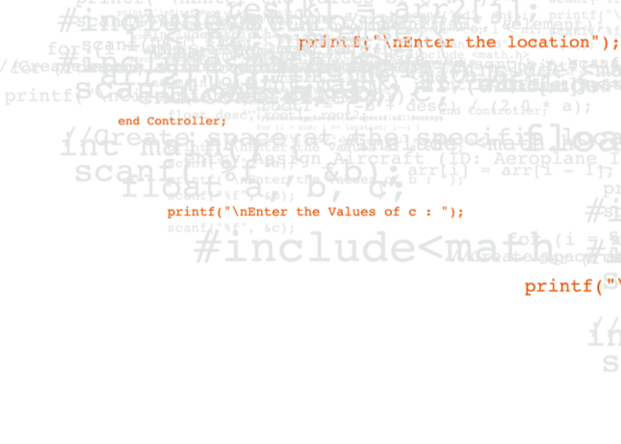

FS Engineering QA Metrics
January 2021
MBR Report
Notes:
Introduction

Slide 2

Contents
Test Execution Metrics (automated).
Defect Trends
EIM/APPS Test Automation Trends.

Slide 3
EIM / SNA QA and Defect Metrics

Slide 4
1 – EIM/SNA QA – Automation Metrics

Slide 5
FS Engineering QA Test Metrics – January 2021
FS Engineering QA metrics reported for test automation execution
QA activity in each Scrum team creates and executes test cases in each Sprint for every new feature developed for a release, which are combined with existing regression and executed through regular test automation runs (weekly, bi-weekly, etc.).
The following slides are current reports on test execution across;
SMBD/RTDE
SMBD and RTDE test coverage of functionality is effectively 100% and tests are run on a weekly basis (Sprints run on a 2-week cycle – hence reports reflect these intervals).
EIM Base Platform / Application Builder .
V8.3.x EIM BP/AB automated test cases are run at least weekly. The metrics on the following slides primarily present the key test execution cycles during ongoing V8.3.x Sprint activity.
WLM
WLM Platform and APPS Scrum teams automate tests for all new functional changes in WLM Platform and APPS 8.3.x. These tests are run in sequence throughout the Sprint cycles as the functionality is delivered to QA team members.
EIM APPS (non-WLM)
APPS 8.3.x automated test cases are run at least weekly. The metrics on this slide present the key test execution cycles during the ongoing APPS 8.3.x Sprint activity.
SMUI (DUX)
SMUI (DUX) 8.3.x automated test cases are run multiple times during each Sprint. The metrics on this slide present the key test execution cycles during the ongoing 8.3.x Sprint activity.
Advanced Analytics Platform.
AAP automated test cases are run on demand at present. The metrics on this slide present the key test execution cycles during the ongoing V8.3.x Sprint activity.

Slide 6
SMBD + RTDE Automation Metrics
Status of current SMBD and RTDE automation – January 2021
SMBD Results >
Total number of automated tests executed in January: 931. The current pass rate is 99.7%
A regression issue (FCENG-15892: SMBD: DSG expects to have 'dataSource' column available.) was found during automation which caused 5 test failures.
Total number of automated tests executed in January: 626. The current pass rate is 100%
RTDE Results >

Slide 7
EIM Base Platform Automation Metrics
Graph of 8.x Complete Automated Test Execution Cycles – January 2021
The failures are existing open defects on FTS and Shared Lists : FCENG-10364, FCENG-12751, FCENG-12720. These defects will be prioritized by Product Owner in future sprints.
Total number of automated tests executed in January are 484. The current pass rate is 93%.

Slide 8
EIM WLM Automation Metrics
Status of current WLM 8.x automated test activity – January 2021
WLM APPS 8.x Results >
Some tests failed due to recent upgrade of cucumeber-java6 where empty values in data tables become null (to be fixed in maintenance ticket). Other failures are due to recent updates to application/existing bugs.
Total number of automated tests executed in January are 372. The current pass rate is 92%
WLM Platform 8.x Results >
Tests failed due to following existing bugs: WLM-7266, WLM-3590, WLM-3586, WLM-3910, WLM-3871, WLM-7420, WLM-6415, WLM-6388, WLM-6514, WLM-6247, WLM-6262, WLM-8501, WLM-7676, WLM-8972, WLM-4675, FCENG-16377, WLM-9750, WLM-10261, WLM-10355.
Total number of automated tests executed in January are 859. The current pass rate is 91%
These defects will be prioritized by the Product Owner in future sprints.

Slide 9
EIM APPS Automation Metrics
Graph of APPS 8.x (non WLM) completed test execution cycles
The above test numbers refer to the non-WLM APPS automated tests executed across three Scrum teams (Archeo, Frogs, and Flash/Fresh - including EIM Framework) for new features on APPS 8.x (using Selenium).
Jan’21 test failures are related to known issues and broken tests within the APPS test automation suite and will be addressed in future Sprints. Total number of automated tests executed in January are 256. The current pass rate is 82.03%
The Fraud team had automated 59 Framework tests that are included in the above graph. The reason for a drop in number of Selenium test cases executed in Aug/Sep post v8.1.1 release is that all the ‘Fraud’ automated pipeline/environments have been stopped until further implementation is required/started.
The Scrum teams Sprint cycles are not exactly aligned into the same timeframe but, for simplicity, the QA metrics have been combined and grouped into monthly cycles.

Slide 10
Scenario Manager DUX Automation Metrics
Graph of 8.x automated tests execution cycles
Tests failed due to following existing bugs: FCENG-12169, FCENG-11025, FCENG-16913, FCENG-14136, FCENG-13067, FCENG-16464, FCENG-17162, FCENG-18027, FCENG-18022.
These defects will be prioritized by the Product Owner in future sprints.
Total number of automated tests executed in January is 336. The current pass rate is 91%.

Slide 11
Advanced Analytics Platform
Advanced Analytics Platform (AAP) completed test execution cycles – January 2021
The volumes of test executions have reduced as the AAP team have been in the process of re-structuring and re-evaluating the Selenium source code for the existing test suite since H2 2020.
The above numbers cover the test automation on an ORACLE platform. Test failures in the last cycle are under review.

Slide 12
2 - EIM/APPS/SNA QA – Monthly JIRA Defect Generation Metrics

Slide 13
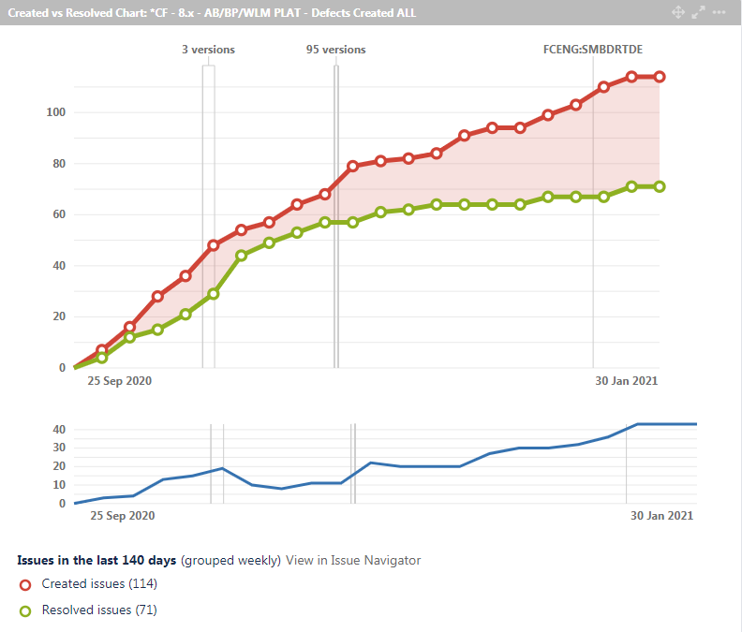
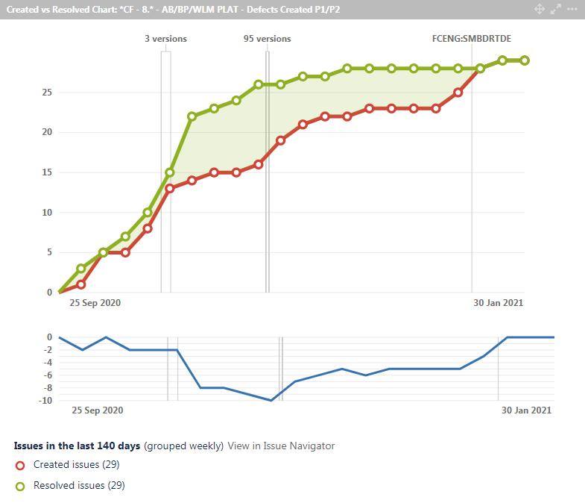
EIM Base Platform Monthly QA Metrics
JIRA Dashboard Metrics on Defect Generation for V8.x – January 2021
Cumulative 8.x Defects Created v Resolved
Cumulative 8.x P1/P2 Defects Created v Resolved
The EIM Base Platform / Application Builder cumulative defect numbers are tracked in JIRA Dashboard widgets. The majority of defects that were created between end of September and end of January 2021 are category P3, P4 and Uncategorized.
The historical trend of open defects at the end of each month has been broadened to show v8.x development phases. Defect resolution is underway in current Sprints in the run up to the 8.3 release, although developer capacity is limited.

Slide 14
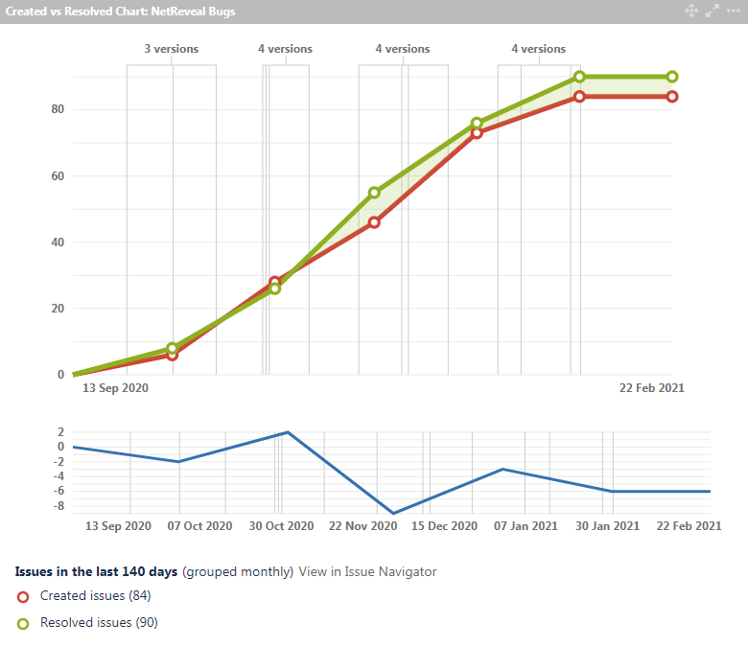
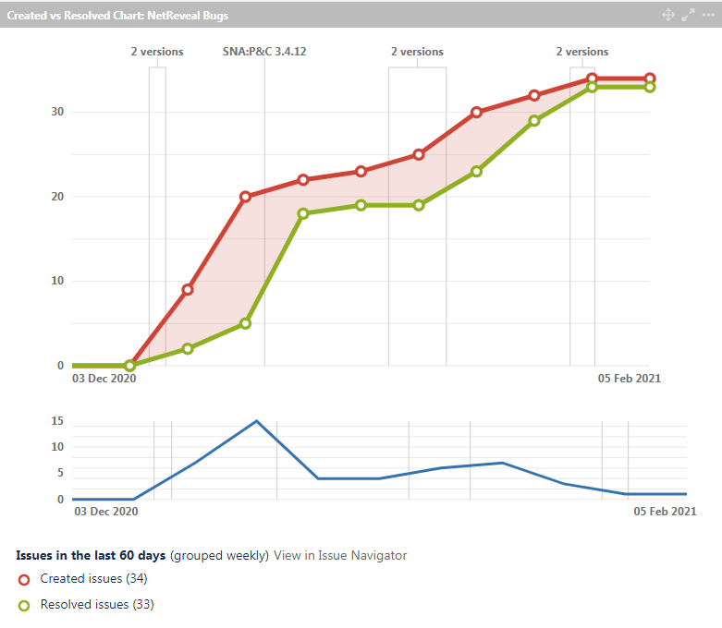
SNA Platform Bugs - Created v Resolved
SNA Platform – Rate of defects created vs resolved – in the last 140 days.
SNA Platform – Rate of defects created vs resolved – in the last 60 days pre and post 3.4.x releases

Slide 15
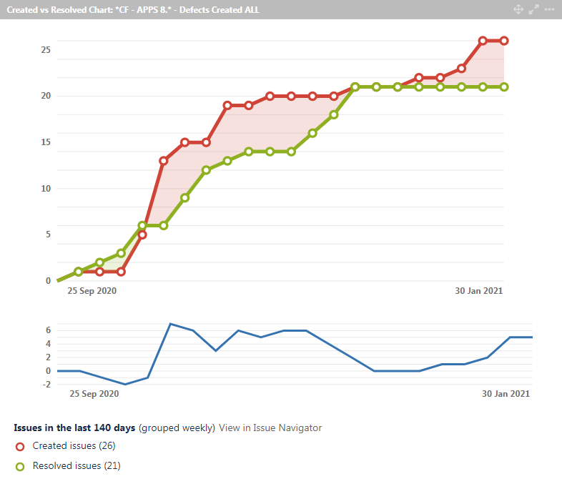
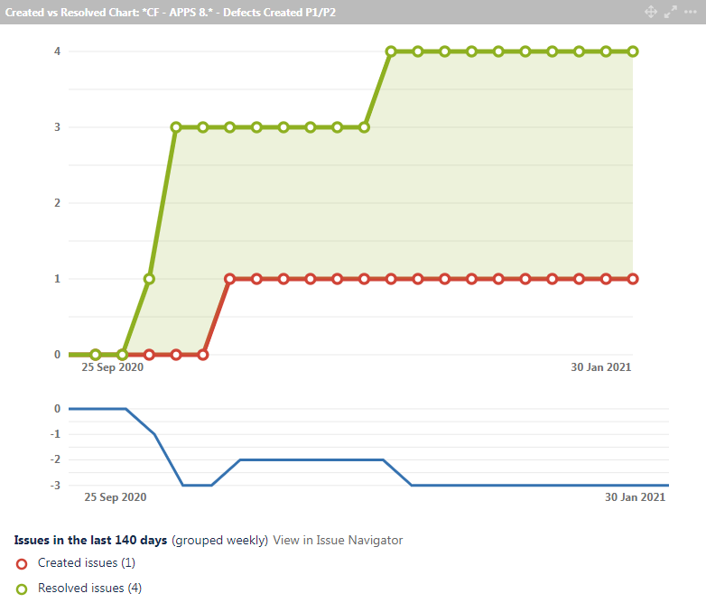
EIM APPS Monthly QA Metrics
JIRA Dashboard Metrics on Defect Generation for APPS 8.x – January 2021
Cumulative APPS 8.x Defects Created v Resolved
Cumulative APPS 8.x P1/P2 Defects Created v Resolved
JIRA Dashboard widgets report on cumulative defect numbers for APPS 8.x development. All the defects that were created between end of September and end of January 2021 are category P3, P4 and Uncategorized.
The ‘Open Defect’ count is collated from the four Scrums teams working on APPS 8.3 deliverables.

Slide 16
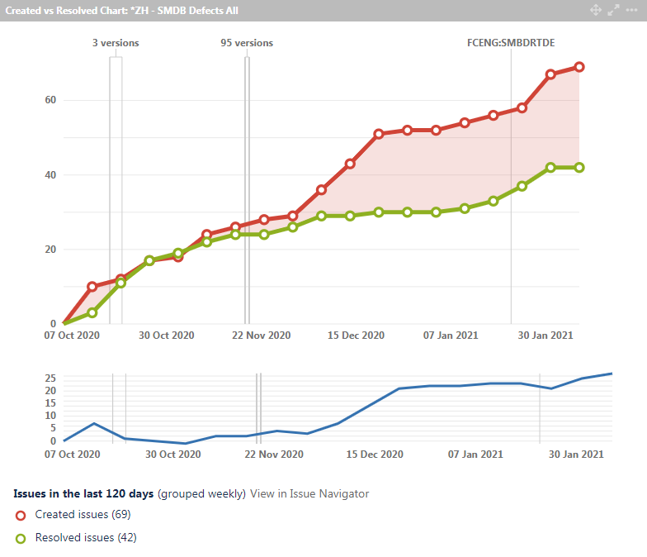
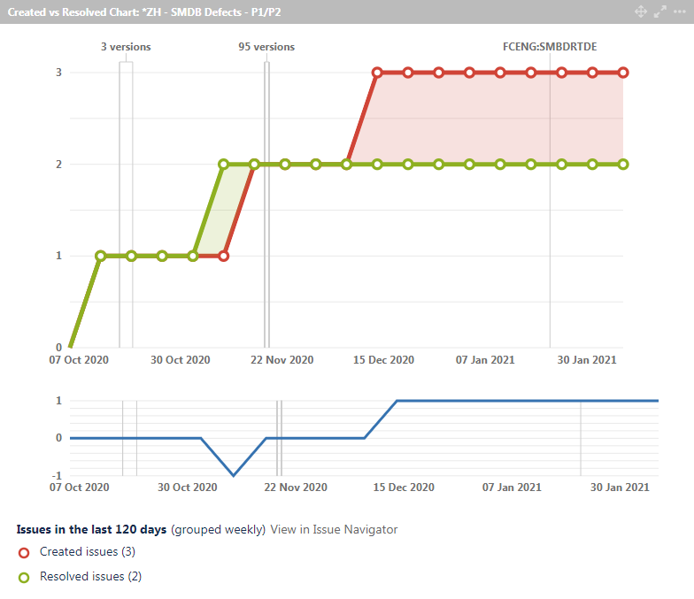
SMBD /RTDE Monthly QA Metrics
JIRA Dashboard Metrics on Defect Generation for SMBD / RTDE – January 2021
Cumulative SMBD and RTDE Defects Created v Resolved
Cumulative SMBD and RTDE P1/P2 Defects Created v Resolved
The above graphs collate defects created in Sprint activity for both current SMBD and RTDE release development. The majority of defects/incidents created between mid of October and end of January 2021 are category P3 and Uncategorized.
The open defect numbers will be tracked at the end of each Sprint cycle.

Slide 17
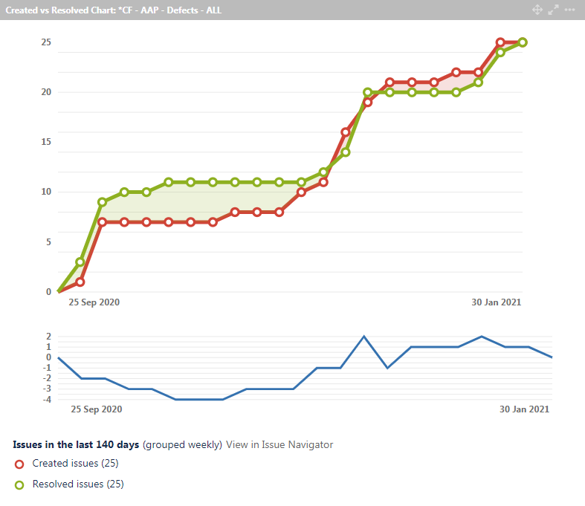
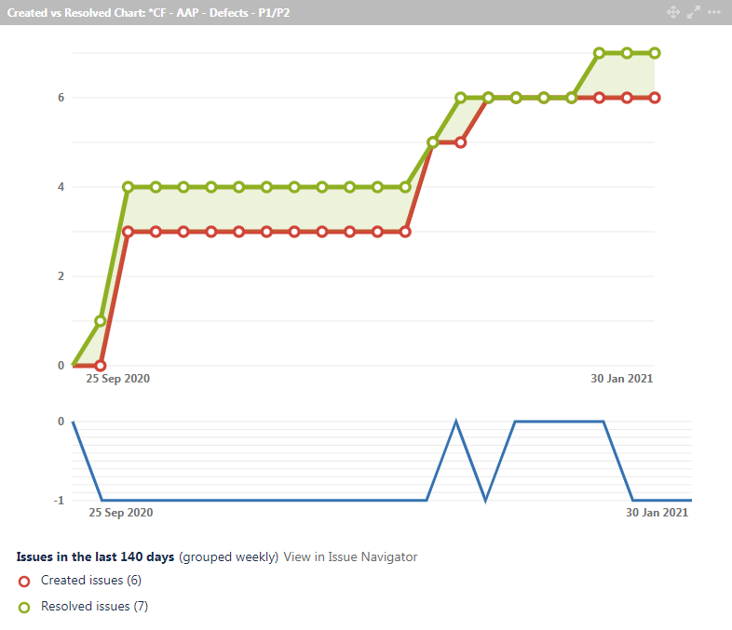
Advanced Analytics Platform QA Metrics
JIRA Dashboard Metrics on Defect Generation for AAP – January 2021
Cumulative AAP Defects Created v Resolved
Cumulative AAP P1/P2 Defects Created v Resolved
The timeframe for the above graphs reflects the AAP Sprint activity for v8.x releases. Most of the defects created between end of September and end of January 2021 are category P3, P4 and Uncategorized.
AAP open defect numbers are tracked at the end of each Sprint cycle, as each Sprint generally corresponds to a calendar month.

Slide 18
QA Automation Metrics/Trends + Coverage – EIM Platform + APPS
2019 and 2020 Increases in QA Test Automation Numbers
Metrics on % Coverage of Regression/New Feature Tests by Test Automation

Slide 19
QA Automation Trend Metrics – SNA Platform
Ongoing Increase in QA Automation (Current numbers of test automation)
We now have ~840 BDD tests, including e2e tests for the complete alert management workflow (triage, investigation, link to case, close as fraud/not fraud), scorecard manager and search.
Numbers are adjusted periodically as redundant test are removed to keep pace with changes in P&C functionality.

Slide 20
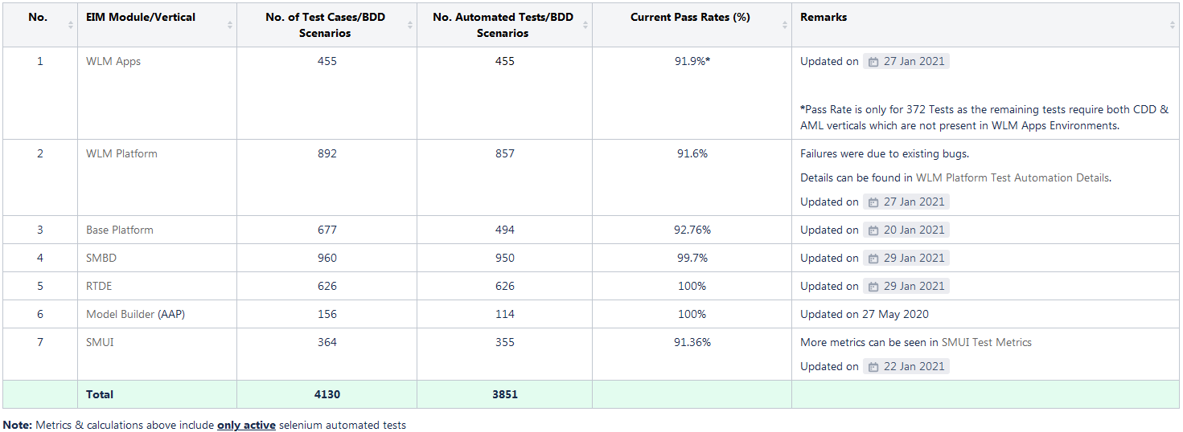
QA Automation Metrics – January 2021
Table from EIM Test Automation Dashboard – includes test automation in 2020/2021
875 APPS (WLM, AML/FinCEN, Fraud, CDD, Framework) Selenuim automation test cases have been written to date from 2017 – 2021. At present the focus by product QA is on building the WLM APPS test suite (455 automated tests). Other APPS Scrum teams have started to build their Selenium test suites (AML/FinCEN:95, Fraud: 164, CDD: 102, Framework: 59).
SM UI (Ducks) test automation have been updated since December 2019. At present 355 out of 364 test cases have been automated.

Slide 21
QA Automation Trend Metrics – EIM Platform
Ongoing Increase in QA Automation (Cumulative Metrics)
Automation Test Coverage - % of Manual Tests
 |  | TC Numbers | Automated TCs | % Coverage
 | Total | 677 | 487 | 73%
Currently, regression suite contains 677 test cases (Test numbers have been reassessed, please refer to the below confluence link fro details), the focus is on automating test cases/scenarios of new features as part of the objective to increase test automation coverage significantly; the current coverage is 73% with 487 automated test cases.
To view the automation and overall test coverage details please follow the below link https://engineering/confluence/display/EIMAPPS/Base+Platform+Test+Automation+Details

Slide 22
QA Automation Trend Metrics – WLM Platform
Ongoing Increase in QA Automation (Cumulative Metrics)
Automation Test Coverage - % of Manual Tests
 |  | TC Numbers | Automated TCs | % Coverage
 | Total | 892 | 857 | 96.1%
Currently, regression suite contains 892 test cases, the focus is to continue automation of new features as part of the objective to increase test automation coverage; the current coverage is 96.1% with 857 automated test cases.
To view the automation and overall test coverage details please follow the below link https://engineering/confluence/display/EIMAPPS/WLM+Platform+Test+Automation+Details

Slide 23
QA Automation Trend Metrics – APPSDEV
Ongoing Increase in QA Automation (Cumulative Metrics)
Automation Test Coverage - % of Manual Tests
 | TC Numbers | Automated TCs | % Coverage
WLM APPS | 1338 | 455 | 34.01%
AML/FinCEN | 95 | 95 | 100.00%
Fraud | 164 | 164 | 100.00%
CDD | 102 | 102 | 100.00%
Framework | 59 | 59 | 100.00%
Total | 1758 | 875 | 49.8%
This metrics excludes CasperJS numbers and focuses on Selenium automation numbers contributed by Scrum teams (WLM APPS, Archeo, Frogs, Flash, and Framework).
Deprecated test cases to date: 225 (AML/EIM Framework/FinCEN), 66 (WLM APPS)
Currently, the test coverage stands at 49.8% and is projected to increase significantly over 2021 and beyond.
WLM APPS test cases have been remapped/recalculated to gauge the automation and overall test coverage. Currently, the regression suite contains 1338 test cases with 455 automated test cases. Please follow the link for details: https://engineering/confluence/display/EIMAPPS/WLM+APPS+Test+Case+Details

Slide 24
QA Automation Trend Metrics – SMBD/RTDE
Ongoing Increase in QA Automation (Cumulative Metrics)
Automation Test Coverage - % of Manual Tests
 |  | TC Numbers | Automated TCs | % Coverage
 | Total | 1586 | 1576 | 99.4%
By the end of 2017 there were 148 automated test cases written in Scala Scripts/Gradle for SMBD by the QA relevant team members. At the end of January 2021, this total figure for SMBD and RTDE has increased to 1576 with 99.4% coverage. Currently, the regression suite contains 1586 test cases.
These automation numbers now include the separate test automation work streams for both the Scenario Manager Big Data (950/960) and Real Time Detection Engine (626/626) modules.

Slide 25
QA Automation Trend Metrics – AAP
Ongoing Increase in QA Automation (Cumulative Metrics)
Automation Test Coverage - % of Manual Tests
 |  | TC Numbers | Automated TCs | % Coverage
 | Total | 156 | 118 | 75.6%
The regression suite contains 156 test cases, test automation coverage is 75.6% with 118 automated test cases.
The trend in automation test case numbers has flattened in H2 2020 and Jan-2021 after the restructure of the AAP project team, which includes the QA team members.

Slide 26
QA Automation Trend Metrics – Scenario Manager UI
Ongoing Increase in QA Automation (Cumulative Metrics)
Automation Test Coverage - % of Manual Tests
 |  | TC Numbers | Automated TCs | % Coverage
 | Total | 364 | 355 | 97.5%
Currently, the regression suite contains 364 test cases, test automation coverage is 97.5% with 344 automated test cases.
To view the automation and overall test coverage details please follow the below link https://engineering/jira/secure/Dashboard.jspa?selectPageId=49762

